Slide 1
Static D2NN
Loss Function Sweep
Practical Limits & Optimal Loss Strategy
D2NN Lab | 2026-04-03
FSO Beam Cleanup Cn²=5×10⁻¹⁴, L=1km, λ=1.55μm

Slide 2
Experiment Overview
10 loss strategies across 3 sweeps, 2 datasets
Sweep | Data | Strategies | Status
0401 | dn100um (Lanczos) | PIB, Strehl, IO, CO+PIB | Complete
0402 | pitch_rescale | Abs Bucket (F), TP+PIB (B), Multiplane (C) | Complete
0403 | pitch_rescale | CO+hardTP, AbsBkt+CO, PIB+hardTP | Complete
10
5000
30
~3h
Loss Strategies
Training Pairs
Epochs Each
Per Strategy (A100)
5-layer D2NN | spacing=10mm | f=4.5mm | N=1024 | dx=2μm | pad=2

Slide 3
Normalized PIB Lies
High PIB does NOT mean high received power
Strategy | PIB@10μm | Throughput | Abs Power vs Turb | Verdict
PIB Only (0401) | 90.1% | 50.7% | 58.7% | LOSS
Strehl Only (0401) | 81.8% | 57.5% | 60.4% | LOSS
Abs Bucket F (0402) | 81.4% | 98.6% | 105.8% | GAIN
TP+PIB B (0402) | 81.6% | 98.4% | 105.8% | GAIN
Multiplane C (0402) | 84.2% | 39.5% | 44.2% | LOSS
CO+hardTP (0403) | 74.0% | 99.3% | 97.0% | ~NEUTRAL
Key Insight: PIB Only achieved 90% PIB but absolute received power was only 58.7% of turbulent baseline. Throughput is the real metric.

Slide 4
Why Does Throughput Drop?
Spatial Filtering Mechanism
1
Phase Mask Pattern
D2NN learns high-frequency phase gratings to redirect energy
2
Angular Vignetting
Diffracted light at large angles exceeds finite aperture (dx=2μm ≫ λ/2=775nm)
3
Aperture Spatial Filter
Energy scattered beyond computational domain is lost at each layer
4
Energy Lost
Turbulent beams lose MORE energy (50%) than vacuum (20-30%)
D2NN acts as aperture-based spatial filter — diffracts energy beyond collection aperture

Slide 5
Received Power Gap Decomposition
 | Total Power | Bucket@10μm | PIB
Vacuum | 290.18 | 277.17 | 95.5%
Turbulent | 278.67 | 217.95 | 78.1%
Gap | 11.51 (4.0%) | 59.22 (21.4%) | 17.4%p
Physical Parameters
WFE = 442.9 nm (2.87λ)
Maréchal limit = λ/14 = 111nm
Strehl = exp(-σ²) = 0.04
Gap origin:
• WFE spreading: 81.8%
• Throughput loss: 18.2%
Bucket Power ≈ TP × exp(-σ²_WFE) × P_diff.limited
Structural Limit: Each sample has random WFE from different turbulence realization. Fixed masks cannot correct random per-sample error → fundamental constraint.

Slide 6
0403 Combined 6-Strategy Results
Focal-plane PIB@10μm with pitch_rescale data, Cn²=5×10⁻¹⁴
Best strategy: TP-PIB w=0.5 achieves highest PIB (81.3%) while maintaining 96.9% throughput. All 0403 strategies preserve throughput >96%.

Slide 7
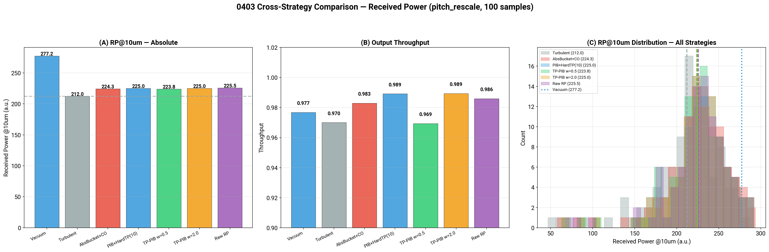
Absolute Received Power Distribution
Turbulent (gray) vs D2NN (color) — 500 test samples, bucket @10μm
+4.0%
+3.3%
+5.2%
+3.3%
+3.8%
AbsBkt+CO
PIB+HardTP
TP-PIB w=0.5
TP-PIB w=2.0
Raw RP

Slide 8
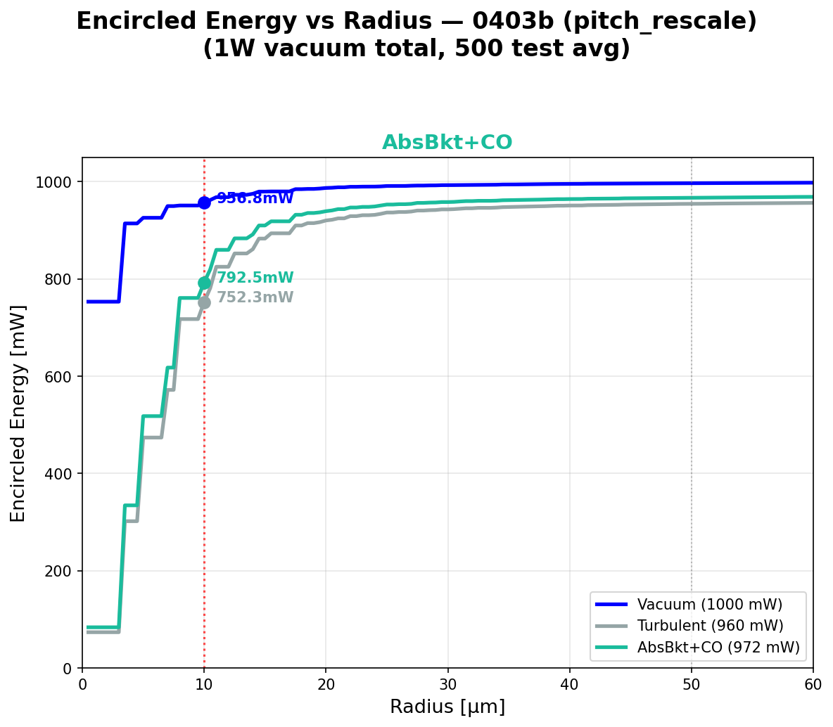
Encircled Energy Analysis
PIB computed at 4 radii: 5μm, 10μm, 25μm, 50μm | All strategies converge at r=50μm

Slide 9
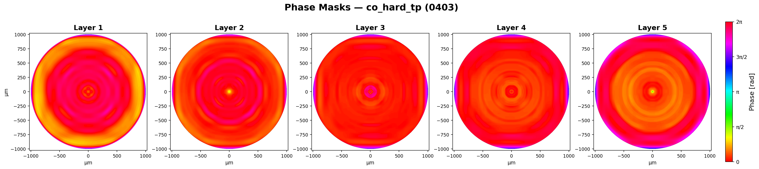
CO Loss: High Throughput, Low PIB
CO+hardTP (0403) — Complex Overlap + Quadratic TP Penalty (λ=10)
99.3%
Throughput
Best across all strategies
74.0%
PIB@10μm
Below turbulent baseline (76.1%)
97.0%
Abs Power
3% loss vs turbulent
Phase masks — nearly flat (minimal spatial filtering)
0.49
Strehl
Far below diffraction limit
Analysis: CO optimizes entire field matching, not bucket concentration. No gradient drives energy into the bucket. Highest TP but worst PIB — confirms CO alone is insufficient for FSO beam cleanup.

Slide 10
Deep Fade & Scintillation Analysis
Scintillation Statistics (dB, vacuum mean = 0 dB)
Deep Fade Worst Cases
 | Mean | Std | Min | 1%ile | 5%ile
Vacuum | 0.00 | 0.00 | 0.00 | 0.00 | 0.00
Turbulent | -1.12 | 0.86 | -7.73 | -3.72 | -2.45
D2NN (F) | -0.85 | 0.74 | -6.36 | -3.25 | -2.00
Rank | Turb | D2NN | Gain
1 | -7.73 dB | -6.36 dB | +1.37 dB
2 | -6.38 dB | -5.20 dB | +1.18 dB
3 | -6.28 dB | -5.05 dB | +1.24 dB
8 | -3.68 dB | -2.66 dB | +1.02 dB
Fade Probability
Threshold | Turbulent | D2NN (F)
< -3 dB | 2.8% | 1.8%
< -5 dB | 0.6% | 0.6%
< -7 dB | 0.2% | 0.0%
D2NN is more effective in deep fades (+1.37 dB worst case) than average (+0.24 dB). Static D2NN acts as a "floor raiser" for worst-case link budget.

Slide 11
Zernike Mode Analysis
Wavefront correction capability by loss strategy
Strategy | Higher-order Δ | Tip/Tilt Δ | Throughput
F/B (Abs Bucket) | ±1 nm | ±0.2 nm | 98%
Multiplane C | -28 nm | +1.3 nm | 40%
PIB Only | -28 nm | +16 nm | 51%
PIB ↔ Throughput : Structural Tradeoff
• When TP is preserved (F/B), Zernike delta ≈ 0 — no wavefront correction
• When TP drops (PIB Only), higher-order corrected -28 nm but tip/tilt added +16 nm
• Static mask trades one aberration type for another via mode conversion
• This confirms: Fixed masks cannot correct random wavefront errors

Slide 12
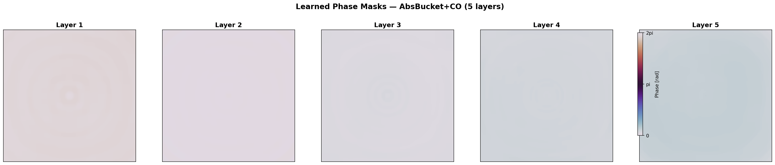
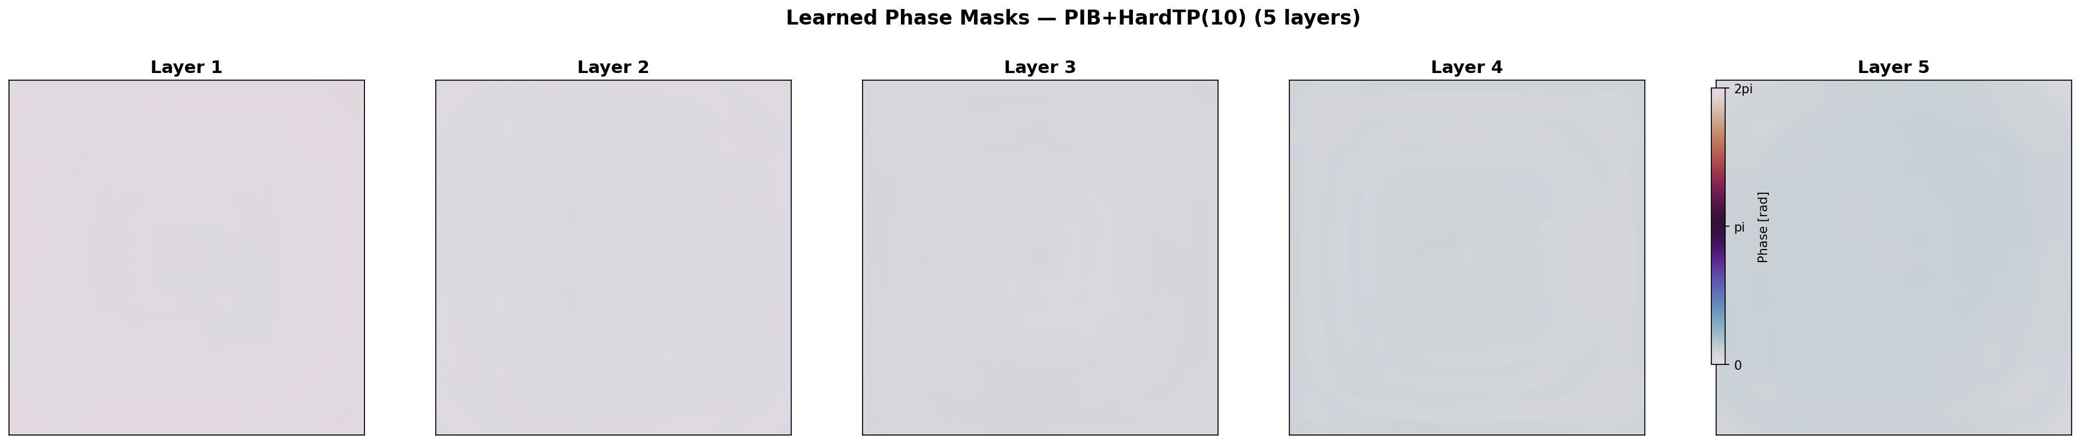
Phase Mask Comparison
AbsBkt+CO — nearly flat masks (TP=98.3%)
PIB+HardTP — also flat masks due to strong TP penalty (TP=98.9%)
All 0403 strategies learn conservative masks — TP penalty prevents aggressive spatial filtering

Slide 13
Optimal Loss Function
Absolute Bucket Loss — direct fiber-coupling optimization
L_abs = 1 - Σ_{r≤10μm} |E_pred^focal|² / Σ_{r≤10μm} |E_vac^focal|²
1
Throughput-aware
Normalizing by vacuum bucket power captures both TP and PIB
2
Gradient-aligned
Every photon directed into bucket reduces loss directly
3
Physics-faithful
Bucket Power ∝ TP × Strehl × P_diff → loss aligns with all three

Slide 14
Conclusions
1
Throughput is the real performance metric. Normalized PIB is misleading.
2
Static D2NN absolute power improvement: +5.8% (+0.24 dB) — Abs Bucket (F) / TP+PIB (B).
3
PIB ↔ Throughput structural tradeoff. Energy concentration via scatter → throughput loss unavoidable.
4
Vacuum PIB (94.2%) is TP-preserved ceiling. WFE=442.9nm (random per-sample) → fixed masks can't correct.
5
Deep fade improvement: +1.37 dB worst case. Static D2NN is a "floor raiser".
6
Absolute bucket loss is the optimal objective. Bucket Power ∝ TP × Strehl × P_diff.
Next: Stronger turbulence (Cn²=10⁻¹³) | Switchable static masks | Hybrid AO+D2NN | Dynamic D2NN (Zernike-based)

Slide 15
Physics Verification
Expert review of equations and physical claims (Codex/GPT-5.4 analysis)
Maréchal Strehl = exp(-σ²)
Exact for Gaussian phase stats, not just small-aberration
CORRECT
L_abs = 1 - Σ|E_pred|² / Σ|E_vac|²
Implicitly couples TP+PIB gradients; ideal for fiber
CORRECT
Bucket ∝ TP × exp(-σ²) × P_diff
Assumes separable TP/WFE; breaks in strong scintillation
APPROX
Spatial filtering mechanism
Angular vignetting, NOT evanescent (dx=2μm≫λ/2)
CORRECTED
PIB ↔ TP structural tradeoff
Real for static masks; not information-theoretic limit
CORRECT
Unitary CO preservation |ΔCO|<0.01
Breaks with finite aperture + multi-layer losses
CORRECT
Zernike tip/tilt addition
Fixed mask adds fixed Zernike; modes affected differently
CORRECT
Deep fade floor effect
Spatial filtering establishes quality floor; expected
CORRECT
Reviewed by Codex (GPT-5.4) | 6/8 fully correct, 1 approximately correct, 1 terminology corrected

